Slide 1
Content Objective: Students will take a strength test and pair up with their future partners based on the results.
Wednesday Oct. 23rd
Introduce Myself
Google Drive Folder / Write a Story
Strength Test / Matching
Homework
During projects only...
Feel free to write and speak in your native language when I ask you questions. If there is someone next to you that you can translate for please do!

Slide 2
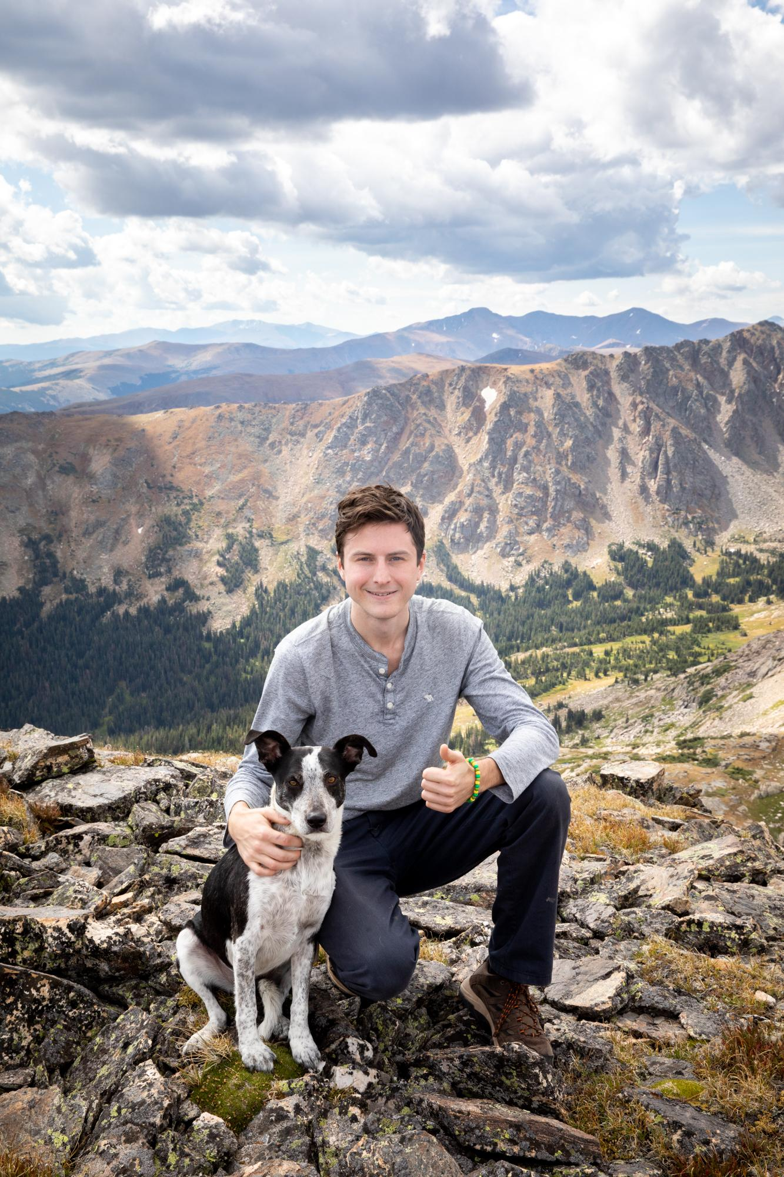

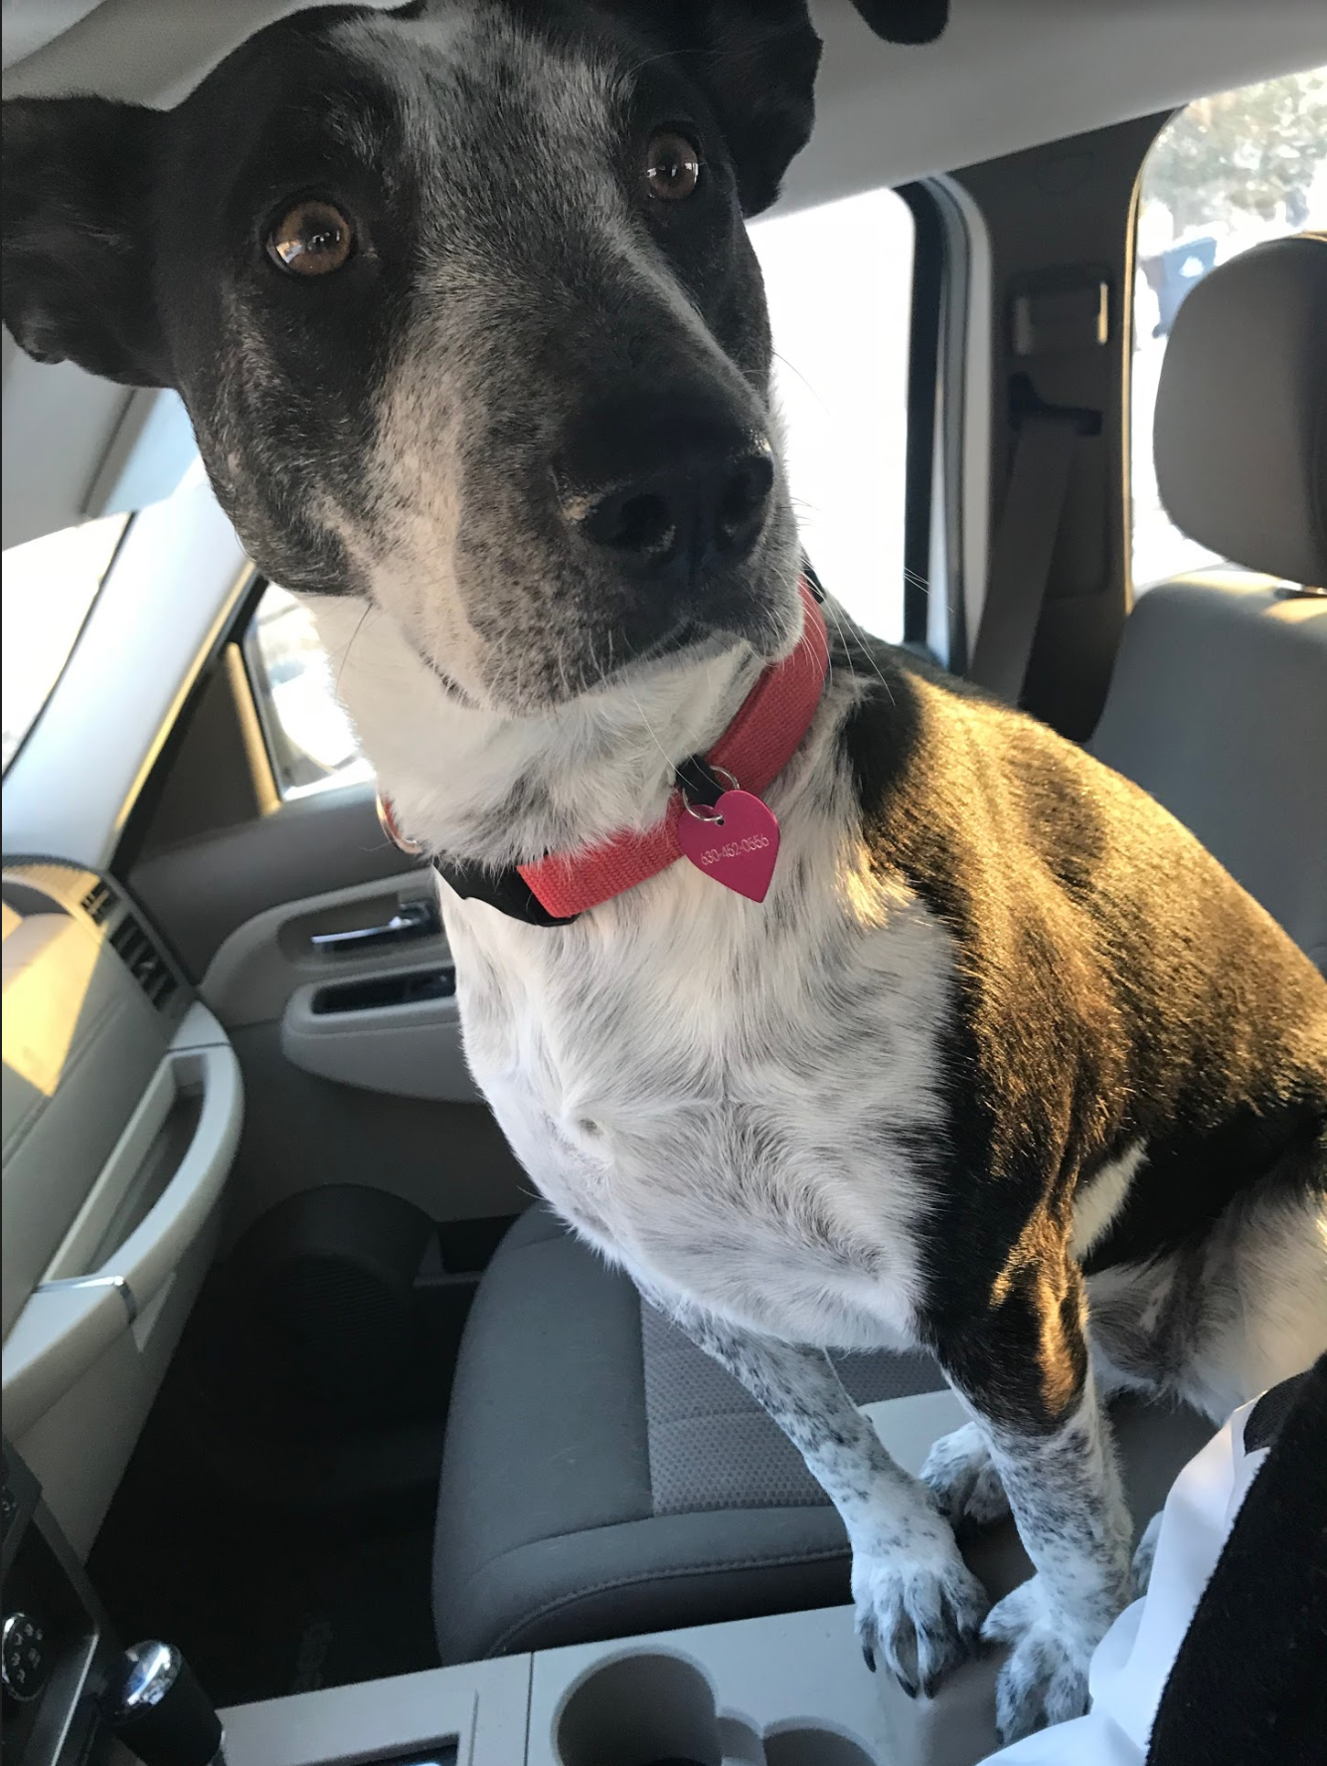

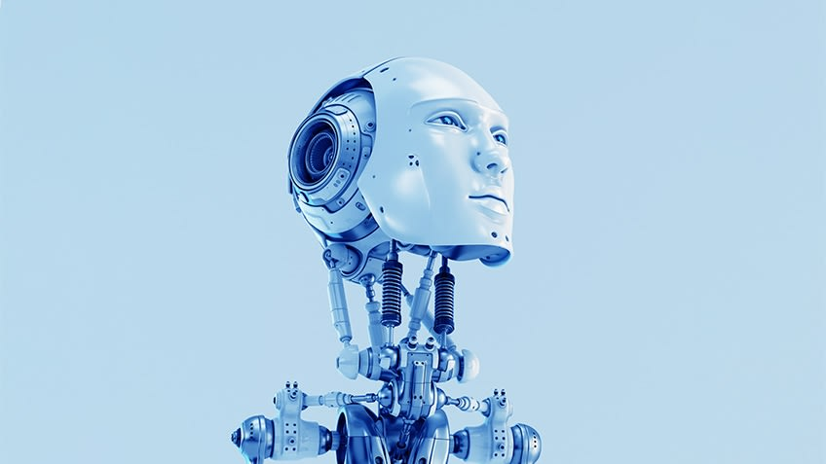
Introduction - Matt Turner
Artificial Intelligence Ethics Teacher

Slide 3
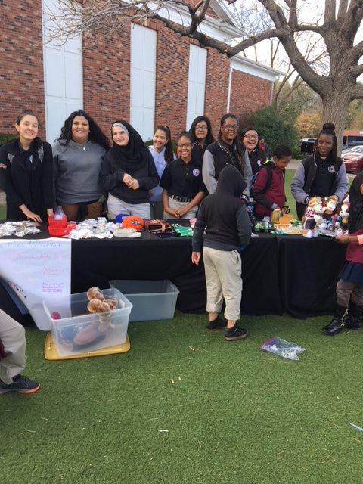
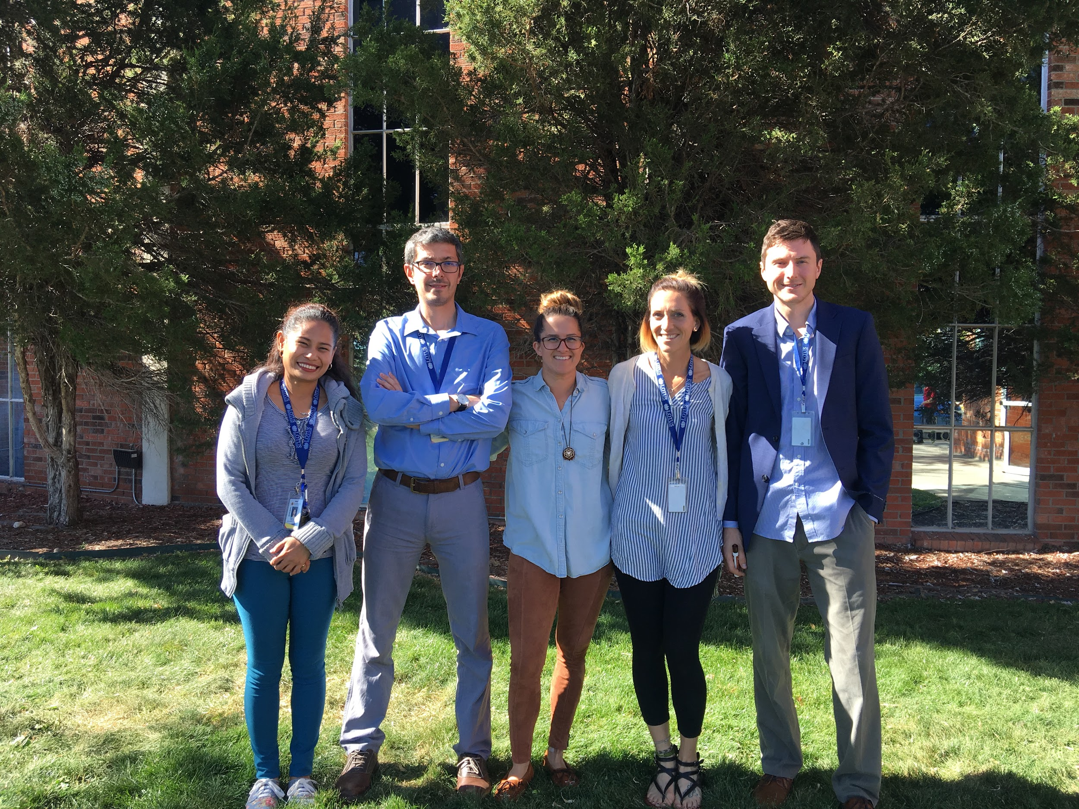
Lotus School for Excellence
Amazing Diversity -
Over 40 Countries
46 Different Languages Spoken

Slide 4

Make a Google Drive Folder - Label “AI Ethics”
Then On a Google Document….
Tell me a story!
Just as I shared my story about how I got here, tell me a life story that will help me understand you and your personality better. It can be anything you feel comfortable sharing.

Slide 5
General Preview of This Course
Unit 1 - Data-Driven Ethical Principles - Gray Area Project
What is ethics?
Abandon ship simulation
Explore different theoretical frameworks
Ethical Code
Unit 2 - Technical Basics of AI - edTed Coding Game
Basic, general, super
The Prison Break
CSU Unplugged
Unit 3 - The 4IR, Automation, & UBI - New Economy Project
Three scenarios-all needs met, no job possibilities, middle class...student create new economy
Impact on Jobs
The industrial revolutions
Unit 4 - AI Morality - Student Driven AI Moral Research / Ideas
Student-driven ethical dilemma
Unit 5 - Ethical AI Application - Student Driven AI Application
This course is yours just as much as it is mine! You will help me create it.

Slide 6
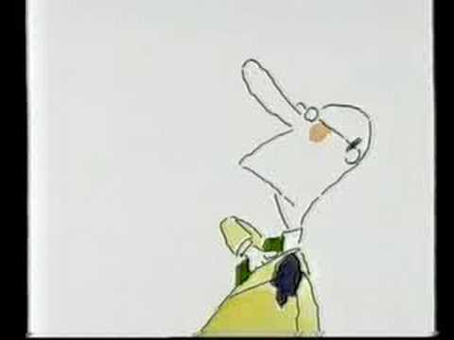
Strength Test - Ever Seen These Commercials?
Red Bull Gives You Wings!
Moon Landing - https://www.ispot.tv/ad/o67u/red-bull-moon-landing

Slide 7



Without needing to drink Red Bull...Let’s figure out how to give you wings...
Go to wingfinder.com

Slide 8
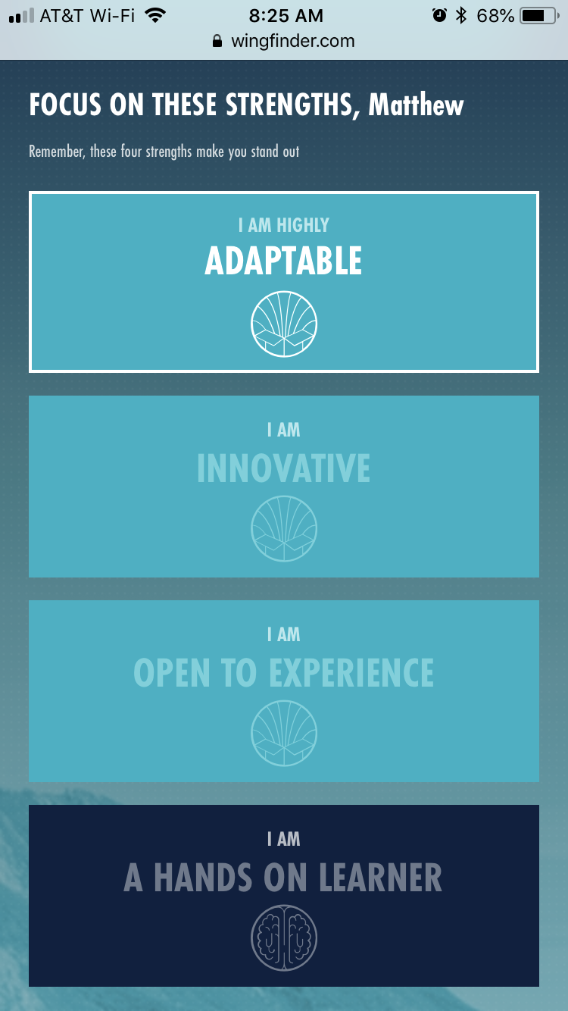

My Results
What am I missing...
Who would I be best matched with?
What about you? Find 1-2 people to complete a group!

